Slide 1
IG Cloud
03-07-2019

Slide 2
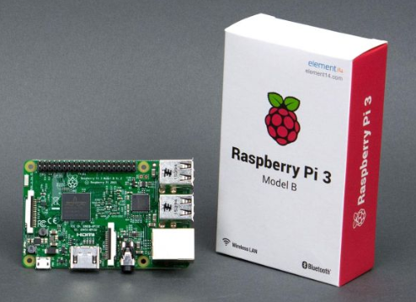
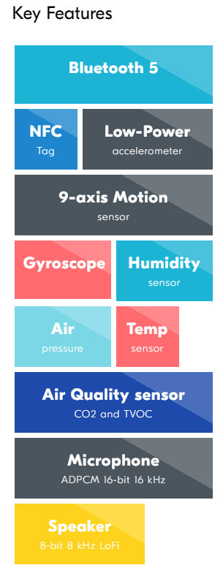

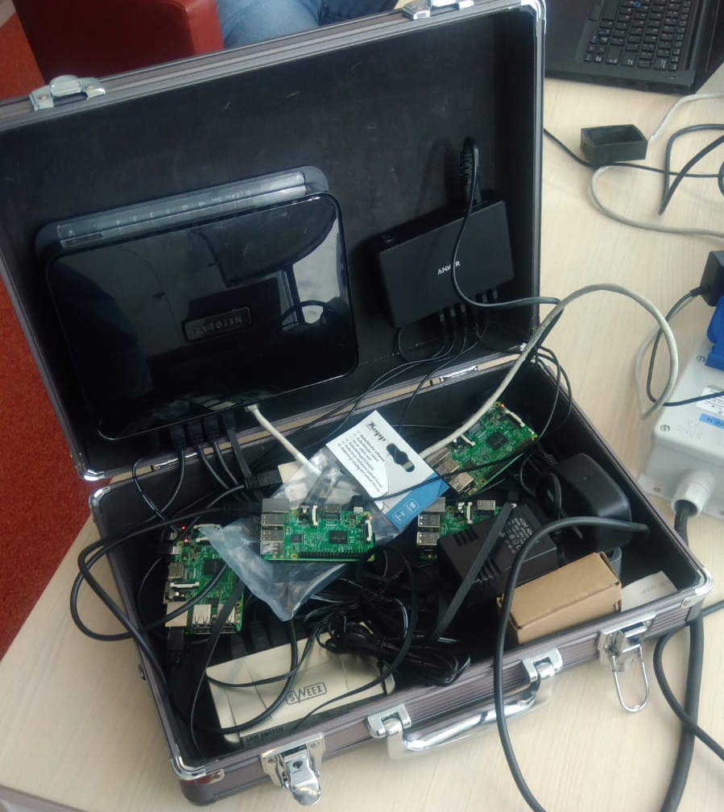
Thingy → Cloud
6x Nordic Thingy:52
6x Raspberry Pi 3
NodeJS application reads from Thingy using BT LE and sends data to AMQP connection
Source: https://github.com/rvsanten/thingy

Slide 3
Pi’s Thingy url: Thingy52
IP 192.168.1.10 pi0 Richard / John
IP 192.168.1.11 pi1 Ahsan
IP 192.168.1.12 p2 Akhil
IP 192.168.1.13 p3 Mark
IP 192.168.1.14 p4 Jip
IP 192.168.1.15 p5 Koen
ssh login : pi, raspberry
git clone https://github.com/rvsanten/thingy.git
sudo node sender.js
amqp://<some server>

